Slide 1


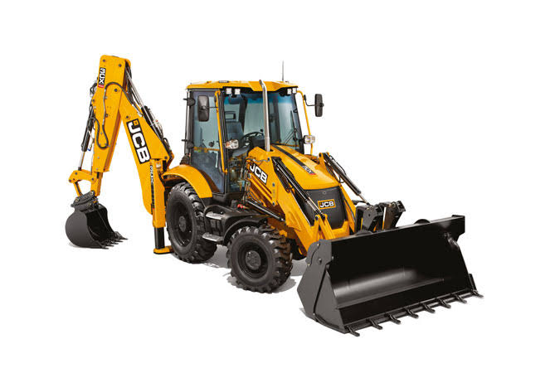
Engine Oil Indicator In Backhoe Loader
Presented by:
M.Praveen (927622BME063)
M.Puviyarasan (927622BME065)
M.Ragul (927622BME066)
Guided By:
Dr.T.Nithyanandam

Slide 2
ABSTRACT
The “Engine Oil Level indicator in backhoe loader ” project addresses the critical need for real-time monitoring of engine oil levels in vehicles and machinery. Maintaining optimal oil levels is essential for engine health, as it ensures proper lubrication, minimizes wear, and prevents overheating. This system utilizes a float sensor, which operates by floating on the engine oil and shifting position in response to oil level changes. The sensor’s movement generates electrical signals that are processed by a microcontroller and displayed for user reference.
This setup allows users to quickly and easily monitor the oil level, reducing the risk of engine damage due to low oil. The project demonstrates the application of basic sensor technology for improved vehicle maintenance and safety. Potential future enhancements include integrating Internet of Things (IoT) technology for remote monitoring and predictive maintenance, further improving reliability and convenience for users.

Slide 3
INTRODUCTION
Engine oil level monitoring is essential to maintain proper lubrication, prevent overheating, and avoid costly engine damage. Manual oil checks are often neglected, leading to potential engine issues. This project, “Engine Oil Level Indication Using Float Sensor,” provides an automated solution using a float sensor to detect real-time oil levels.
The sensor’s readings are processed by a microcontroller and displayed, giving users a quick view of the oil status. This system enhances maintenance efficiency and reliability, making it suitable for vehicles, heavy machinery, and industrial applications.

Slide 4
LITERATURE SURVEY
Traditional Methods: Manual oil checks (e.g., dipsticks) are commonly used but require regular user maintenance, which can be inconvenient and often overlooked.
Importance of Automation: Research highlights the benefits of automated oil level monitoring for better maintenance and engine health, especially in high-demand or continuous-operation environments.
Effectiveness of Float Sensors: Mahmud et al. (2020) and Zhang & Li (2019) found float sensors to be reliable and cost-effective for real-time oil level monitoring. Float sensors are accurate and simple to use, offering a practical solution for automotive and industrial applications.
Project Relevance: This project everages these findings to create a cost-effective, user-friendly oil level indication system using float sensor technology.

Slide 5
PROBLEM STATEMENT
Engine Health and Maintenance: Maintaining optimal engine oil levels is essential for proper lubrication, preventing overheating, and reducing wear and tear on engine components.
Limitations of Manual Checks: Traditional oil level checks require manual inspection, which can be inconvenient, easily neglected, and impractical in high-demand or continuously operating machinery.
Risk of Engine Damage: Low or insufficient oil levels can lead to engine damage, costly repairs, and potentially catastrophic failure if not addressed in time.
Need for Automation: There is a need for a reliable, automated system to monitor engine oil levels in real time, reducing reliance on manual checks and enhancing maintenance efficiency.

Slide 6
METHODOLOGY
Component Selection: Use a float sensor (stainless steel) to detect oil level changes.Select a microcontroller to process sensor signals.Integrate a display module (e.g., LED/LCD) for visual feedback.
Circuit Design: Connect the sensor, microcontroller, and display with proper power supply.Design for stable operation with minimal signal noise.
Signal Processing: Program the microcontroller to interpret sensor data and display accurate oil levels.Calibrate the system for reliable readings under different conditions.
Testing: Test the system in various conditions (temperature, vibrations) to ensure accuracy.Adjust calibration for precise oil level detection.

Slide 7
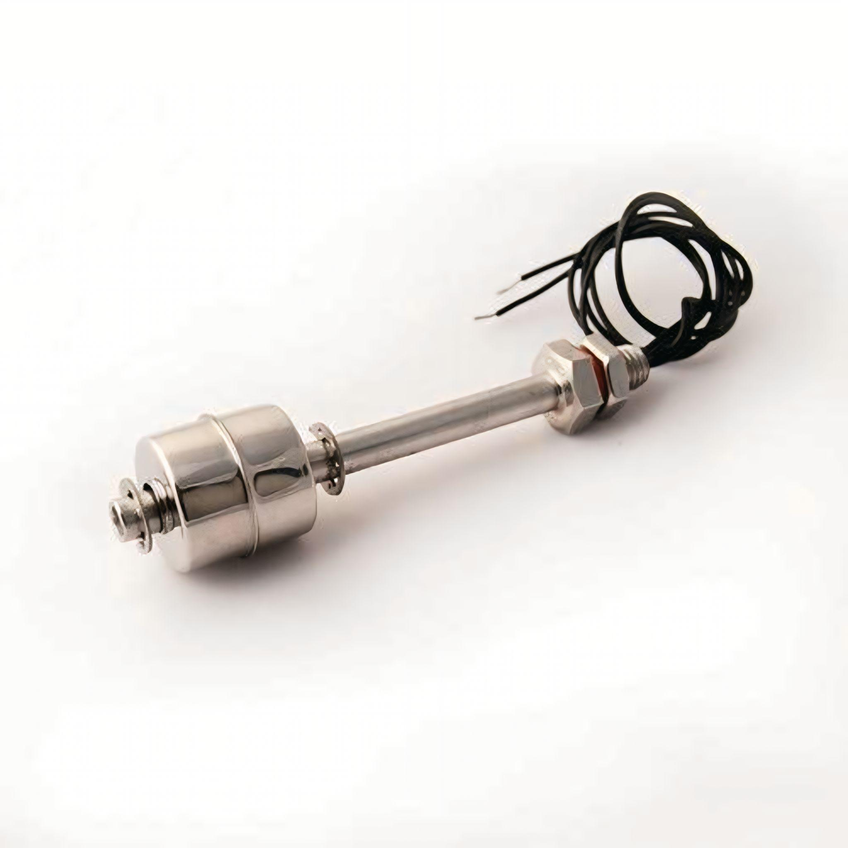

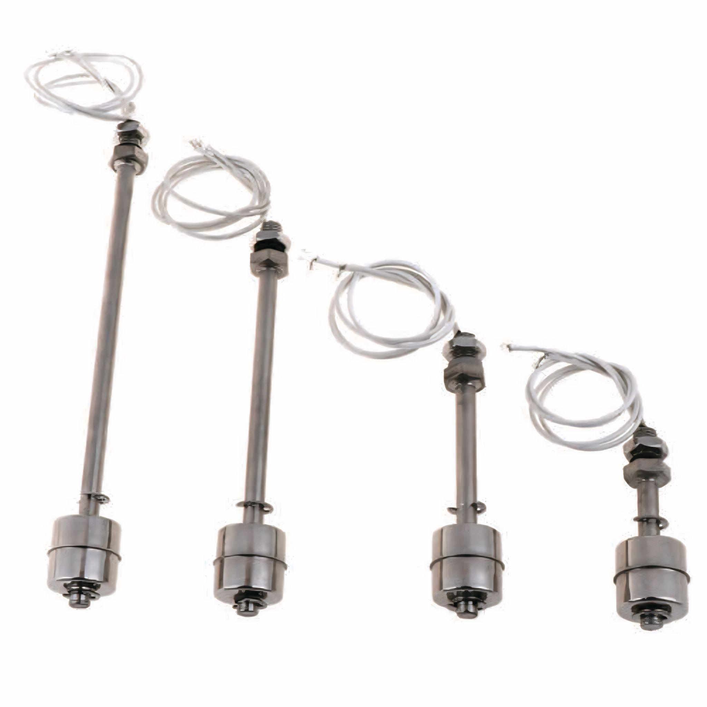
DESIGN

Slide 8
RESULT AND DISCUSSION
Accurate Oil Level Detection: The float sensor is expected to accurately detect changes in oil levels, with the microcontroller processing the signal for real-time oil level display. Real-time Monitoring: Continuous, automated oil level monitoring will provide immediate feedback to the user, with low oil level alerts triggered as needed. System Reliability: The system is expected to function reliably under typical conditions, including engine vibrations and temperature changes, ensuring consistent performance. User-Friendly Interface: The digital display is designed to present clear, easy-to-read oil level data, enabling users to assess oil levels quickly.

Slide 9
COST ESTIMATION
NAME OF PRODUCT | QUANTITY | COST OF PRODUCT
FLOAT SENSOR (STAINLESS STEEL) | 1 | 1500
MICROCONTROLLER | 1 | 500
DISPLAY MODULE | 1 | 500
WIRING AND CONNECTION | REQUIRED | 200
 | TOTAL | 2700

Slide 10
ADVANTAGES AND APPLICATION
Accurate Monitoring: Provides real-time, accurate detection of oil level. Automation: Eliminates the need for manual checks. Durable: Stainless steel float sensors are corrosion-resistant and reliable under harsh operating conditions. User-Friendly: Digital displays offer easy-to-read oil level data for quick user assessment. Prevents Engine Damage: Early detection of low oil levels helps avoid overheating, friction, and potential engine failure.
Backhoe Loaders: The system can be used to monitor engine oil levels in backhoe loaders, ensuring that the engine operates efficiently and preventing potential damage due to low oil levels during demanding operations.

Slide 11
CONCLUSION
The “Engine Oil Level Indication Using Float Sensor” system provides an effective, cost-efficient solution for monitoring oil levels in backhoe loaders. By automating the oil level check, it reduces the need for manual inspections and enhances engine maintenance, preventing potential damage caused by low oil levels. The use of a stainless steel float sensor ensures durability and reliability in harsh operating conditions.
This system offers several advantages, including real-time oil level monitoring, user-friendly displays, and low maintenance requirements. Its practical application in backhoe loaders demonstrates its potential to improve engine performance, reduce downtime, and increase the longevity of machinery in the construction and agricultural industries.

Slide 12
REFERENCE
Mahmud, M., et al. (2020). “Development of an Automated Engine Oil Level Monitoring System Using Float Sensors.” Journal of Engineering and Technology, 12(3), 45-52. Zhang, X., & Li, Y. (2019). “Oil Level Sensing in Automotive Engines Using Float Sensors.” International Journal of Automotive Engineering, 8(2), 114-121. Patel, R., et al. (2021). “Comparative Study of Oil Level Monitoring Technologies in Industrial Machinery.” Journal of Industrial Automation, 15(1), 31-40. Singh, A., & Kumar, P. (2022). “Design and Implementation of an Oil Level Monitoring System for Heavy Machinery.” Journal of Mechanical Engineering Applications, 18(4), 22-28.

Slide 13


